Slide 1

Subject Code
18MEO113T - Design of Experiments
Handled by
S. Murali, Ph.D.,
Associate Professor,
Department of Mechanical Engineering, SRM IST, Kattankulathur.
Disclaimer
The content prepared in the presentation are from various sources, only used for education purpose. Thanks to all the sources.

Slide 2
18MEO113T – Design of Experiments
To learn the fundamentals of design of experiment techniques.
To familiarize in how to setup experiments and accomplish all analyze tasks using software packages like Minitab, etc.
After this course, You will be ready to apply the technique confidently to all of your projects .

Slide 3
Course Plan

Slide 4
Unit 1
1: Introduction in Design of Experiments (DOE).
2: The fundamental and potential practical problems in experimentation
3: Statistical thinking and its role with DOE
4: Basic principles of DOE and Degrees of Freedom
5: Selection of quality characteristics for experiments
6: Understanding key interaction in processes
7: An alternative method for calculating two-order interaction effect
8: Synergistic interaction, Antagonistic interaction
9: Synergistic interaction verus Antagonistic interaction

Slide 5
What is Experiment?
Experiment is an important activity performed by all in day to day activity.
An experiment is a test or a series of tests conducted to analyse, understand or improve the system.
The only way to learn anything about a system is to disturb it and then observe it.

Slide 6
What is Experiment?
An Experiment as a test or series of runs in which purposeful changes are made to the input variables of a process or system so that we may observe and identify the reasons for changes that may be observed in the output response.
Observations on a system or process can lead to theories or hypotheses about what makes the system work, but experiments are required to demonstrate that these theories are correct.

Slide 7
What is Experiment?
Efficiency is doing the least amount of work and getting the most information.
Objective is to improve the outcome and there are two or more factors we can change to make that improvement or influence the outcome.
So, there's an outcome/response and there are factors that we want to improve.

Slide 8


What is Experiment?
Aluminium Pot
Ceramic Pot
Constant Heat,
Same amount of water
Outcome : Time taken to Boil
Other Variables : source of heat, without lid, Material, shape of pot etc…

Slide 9
What is Experiment?
Aluminium Pot
Ceramic Pot
Constant Heat,
Same amount of water
Control Variable: Aluminum Pot
Experiment Variable: Ceramic Pot
Independent Variable: Type of material used for pot
Dependent Variable: Time taken to Boil
Outcome : minimize the time taken to Boil
Other Variables : source of heat, without lid, Material, shape of pot etc…

Slide 10
What is Experiment?
Outcomes = Response
Variables / Attributes = Factors
Types of factors:
Numeric: Quantative
Categorical : Qualitative
Objective:
Combine outcome by adjusting choosing the variable
Some Examples: Maximize the profit, yield, Minimise the expense, loss, energy

Slide 11



What is Experiment?
Spike shoe
Same person, day, playground
Sports shoe
Outcome : Time taken to reach Target
Other Factors : Weather, Cloth, location

Slide 12
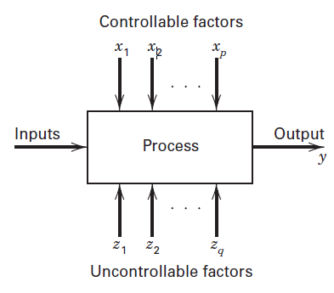
Process Model
Determining which Control variables (Input) X, are most influential on the response (output), y
Determining where to set the influential ‘x’ so that ‘y’ is almost always near the desired nominal value.
Determining where to set the influential ‘x’ so that variability in ‘y’ is small.
Determining where to set the influential ‘x’ so that the effect of uncontrollable variables ‘z’ are minimized.

Slide 13
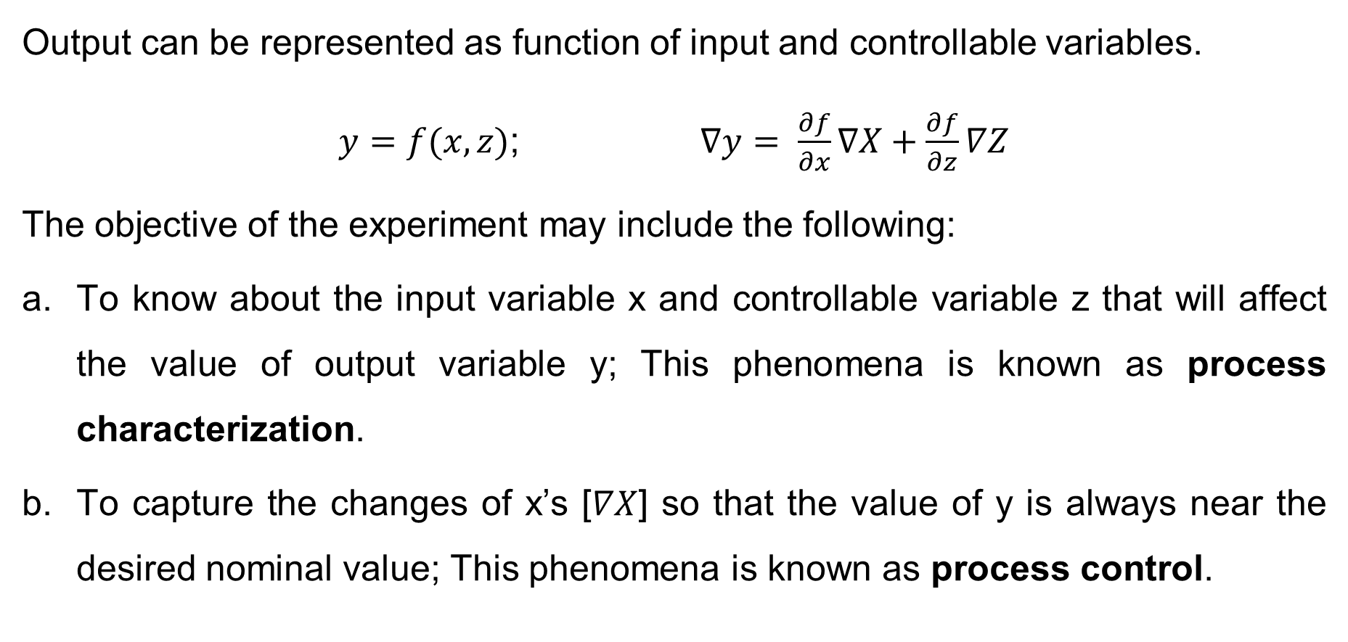
Objective with Mathematical expression
Output can be represented as function of input and controllable variables.
$y=f(x,z)$; $∇y= \frac{∂f}{∂x}∇X+\frac{∂f}{∂z}∇Z$
The objective of the experiment may include the following:
To know about the input variable x and controllable variable z that will affect the value of output variable y; This phenomena is known as process characterization.
To capture the changes of x’s [$∇X$] so that the value of y is always near the desired nominal value; This phenomena is known as process control.

Slide 14
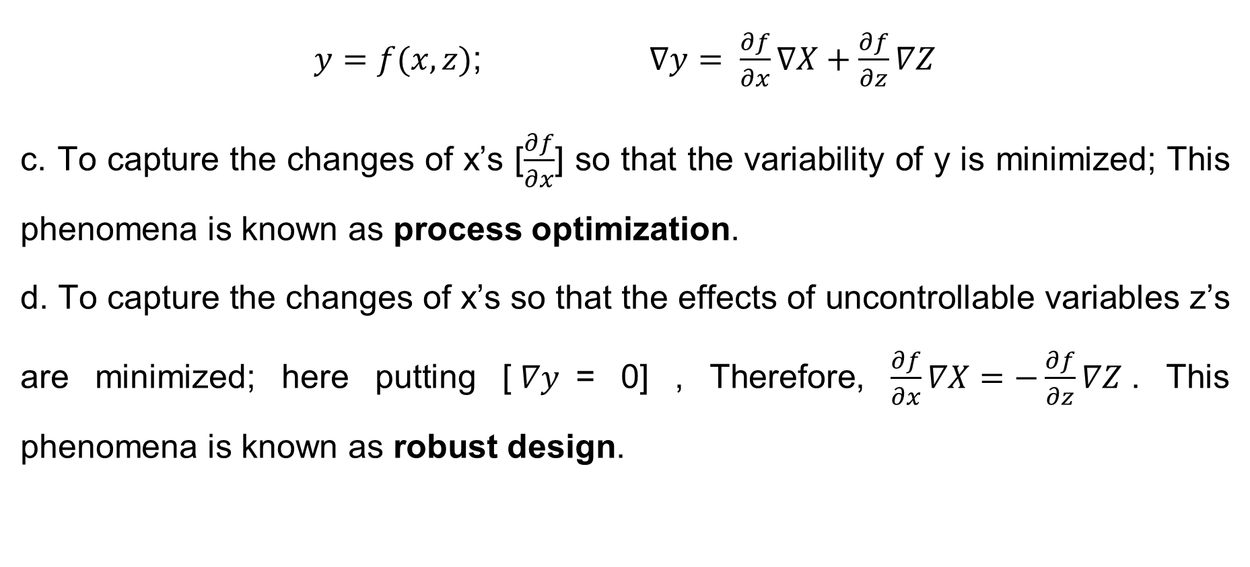
Objective with Mathematical expression
$y=f(x,z)$; $∇y= \frac{∂f}{∂x}∇X+\frac{∂f}{∂z}∇Z$
c. To capture the changes of x’s [$\frac{∂f}{∂x}$] so that the variability of y is minimized; This phenomena is known as process optimization.
d. To capture the changes of x’s so that the effects of uncontrollable variables z’s are minimized; here putting [$∇y$= 0] , Therefore, $\frac{∂f}{∂x}∇X=−\frac{∂f}{∂z}∇Z$. This phenomena is known as robust design.

Slide 15
DOE Terminology
Response
A measureable outcome of interest. Eg: Time, etc.
Factors
Controllable variables that are deliberately manipulated to determine the individual and joint effects on the response(s), OR Factors are those quantities that affect the outcome of an experiment, Example: heat source, lid, shape of pot etc.
Levels
Levels refer to the values of factors i.e., the values for which the experiments will be conducted
Eg: Level – 1 heat input = low & Level – 2 heat input = high

Slide 16
DOE Terminology
Treatment
A set of specified factor levels for an experiments or run
Treatment – 1: Heat input = low and with lid
Treatment – 2: Heat input = high and without lid
Noise
Variables that affect product/ process performance, whose values cannot be controlled or are not controlled for economic reasons. Eg. Climate, environment, etc….
Replication
Replication is a systematic duplication of series of experimental runs. It provides the means of measuring precision by calculating the experimental error.

Slide 17
DOE Terminology
Factor
A variable or attribute which influences or is suspected of influencing the characteristic being investigated.
All input variables which affect the output of a system are factors
Factors are varied in the experiment
They can be controlled at fixed levels.
They can be varied or set at levels of our interest.

Slide 18
DOE Terminology
Factor
Two types of variables or factors : quantitative and qualitative
Quantitative – how the range of settings to be measured and controlled e.g. temperature , pressure in the process yield experiment
Qualitative – discrete in nature ; requires more levels
e.g. types of raw materials, type of catalysts, type of supplier, etc.
– These are also called independent variables.

Slide 19
DOE Terminology
Level
Specified value or setting of the factor being examined in the experiment.
The values of a factor/independent variable being examined in an experiment.
If the factor is an attribute, each of its state is a level.
For example, setting of a switch on or off are the two levels of the factor switch setting.

Slide 20
DOE Terminology
Level
If the factor is a variable, the range is divided into required number of levels.
For example, the factor temperature ranges from 1000 to 1200°C and it is to be studied at three values say 1000°C, 1100°C and 1200°C, these three values are the three levels of the factor temperature.
The levels can be fixed or random.

Slide 21
DOE Terminology
Treatment
One set of levels of all factors employed in a given experimental trial.
For example, an experiment conducted using temperature T1 and pressure P1 would constitute one treatment.
In the case of single factor experiment, each level of the factor is a treatment.
Run or trial :
a trial or run is a certain combination of factor levels whose effect on the output (or performance characteristic) is of interest.

Slide 22
DOE Terminology
Experimental unit
Facility with which an experimental trial is conducted such as samples of material, person, animal, plant, etc.
Response:
The result/output obtained from a trial of an experiment. This is also called dependent variable. Examples are yield, tensile strength, surface finish, number of defectives, etc.
Effect :
Effect of a factor is the change in response due to change in the level of the factor.

Slide 23
DOE Terminology
Experimental error:
It is the variation in response when the same experiment is repeated, caused by conditions not controlled in the experiment.
It is estimated as the residual variation after the effects have been removed.

Slide 24
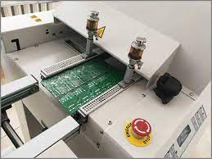
Example
Example 1: A flow solder machine is used in the manufacturing process for printed circuit boards. The process engineer would like to conduct a designed experiments to determine which controllable variables is significantly affecting the output quality. And also, to find out the way to reduce the variability of output due to change in uncontrollable variable.
Control variables
Process
Output (Reducing solder defects)
Input (solder)
Un-Controlled variables

Slide 25
Example
Controllable factors
Solder temperature
Preheat temperature
Conveyor speed
Flux Type
Flux specific gravity
Solder wave depth
Conveyor angle
Un-Controllable factors
Thickness of the printed circuit board
Types of components used on the board
Layout of the components on the board
Operator
Production rate

Slide 26
Example
Example 2: In this example, we are interested to improve the yield of a chemical process through using the two most important process variables: reaction time (x1) and operating temperature (x2). As the given response surface is unknown to the process personnel, experimental set up will be required to investigate it.
x2
(80,180)
(90,180)
Temperature & Reaction Time
Output (Improving the yield of a chemical process)
x1
Process
Chemical
(80,170)
(90,170)

Slide 27
Example
Example 3: The response variables of interest in designing an aircraft engine are fuel consumption and engine thrust. The engineer in-charge uses a computer model of the system where he can vary the following designed parameters (inlet flow, fan pressure ratio, overall pressure, stator outlet temperature) to optimize the performance of the engine.
1 2 3 4
Fuel consumption
Process
Computer model
Engine thrust

Slide 28
Strategy of Experimentation
Experimental Strategies
Best Guess
Conventional Strategy
Strategic Design
One factor at a Time
Several Factors, one at a Time
Several factors, all at same time

Slide 29
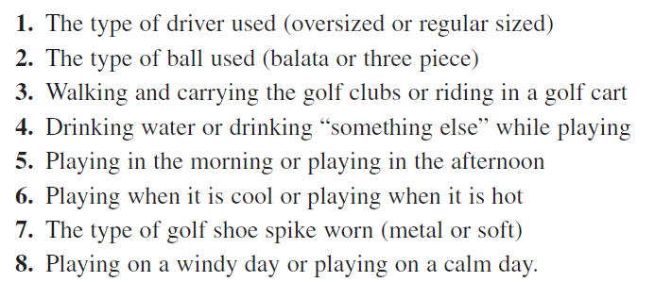
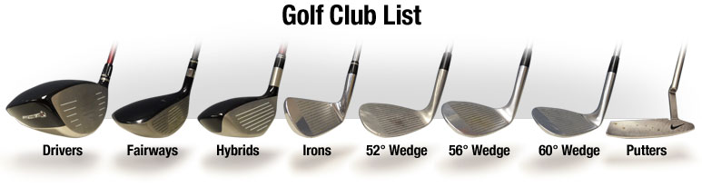
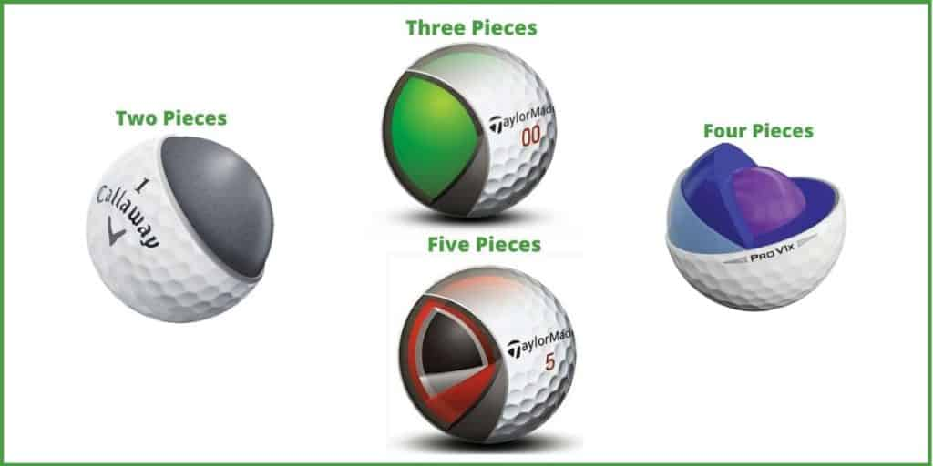
Best-Guess Approach
Best-Guess Approach
Eg: Play Golf / Machining a part / Preparing a concrete / Preparing a sample for new application / etc.

Slide 30
Best-Guess Approach
Best-Guess Approach
Disadvantages.
First, suppose the initial best-guess does not produce the desired results. Now the experimenter has to take another guess at the correct combination of factor levels. This could continue for a long time, without any guarantee of success.
Second, suppose the initial best-guess produces an acceptable result. Now the experimenter is tempted to stop testing, although there is no guarantee that the best solution has been found.

Slide 31
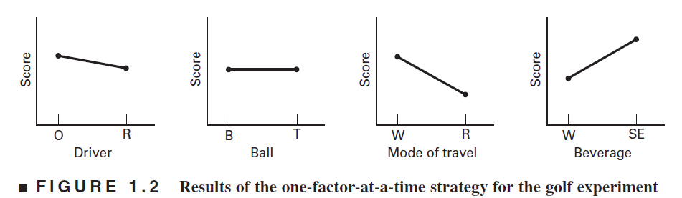
Conventional Strategies
One Factor at a Time (OFAT)
The OFAT method consists of selecting a starting point, or baseline set of levels, for each factor, and then successively varying each factor over its range with the other factors held constant at the baseline level. After all tests are performed, a series of graphs are usually constructed showing how the response variable is affected by varying each factor with all other factors held constant.

Slide 32
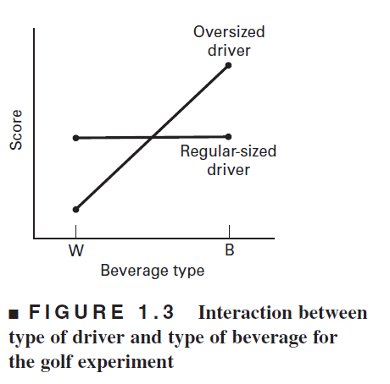
Conventional Strategies
One Factor at a Time (OFAT)
Disadvantage. OFAT method fails to consider any possible interaction between the factors.
Interactions between factors are very common, and if they occur, the OFAT strategy will usually produce poor results

Slide 33
Conventional Strategies
One Factor at a time
Several Factor One at a time
Trial | Factor | Test Result |  | Test Average
1 | A1 | - | - | Y1
2 | A2 | - | - | Y2
Trial | Factor |  |  |  | Test Result |  | Test Average
 | A | B | C | D
1 | 1 | 1 | 1 | 1 | - | - | Y1
2 | 2 | 1 | 1 | 1 | - | - | Y2
3 | 1 | 2 | 1 | 1 | - | - | Y3
4 | 1 | 1 | 2 | 1 | - | - | Y4
5 | 1 | 1 | 1 | 2 | - | - | Y5

Slide 34
Conventional Strategies
Several Factors at same time
Disadvantage:
Not possible to attribute the change in result to any of the factor/s.
Effect of interaction between factors cannot be studied
These are poor experimental strategies and there is no scientific basis. The results cannot be validated
Trial | Factor |  |  |  | Test Result |  | Test Average
 | A | B | C | D
1 | 1 | 1 | 1 | 1 | - | - | Y1
2 | 2 | 2 | 2 | 2 | - | - | Y2

Slide 35
Strategy Design
Full Factorial Design
Trial | Factor |  | Response
 | A | B
1 | 1 | 1 | - | -
2 | 1 | 2 | - | -
3 | 2 | 1 | - | -
4 | 2 | 2 | - | -
It is balanced and also orthogonal
Factor A does not influence the estimate of the effect of factor B and vice versa.
Both factor and interaction effects can be estimated.
Limitation
Only few factors can be investigated
When several factors are to be investigated, the number of experiments to be run under full factorial design is very large.

Slide 36
Need for Strategy Design
To obtain unambiguous results at minimum cost.
Permits consideration of all possible variables/factors simultaneously
A valid evaluation of the main factors effects and the interaction effects can be obtained.
With limited number of experiments the crucial factors can be obtained.
The statistical concepts used in the design form the basis for validating the results

Slide 37
Statistical Thinking and its Role within DOE
One of the success factors for the effective deployment of DOE in any organization is the uncompromising commitment of the senior management team and visionary leadership.
However, it is not essential that the senior managers have a good technical knowledge of the working mechanisms of DOE.

Slide 38
Statistical Thinking and its Role within DOE
Statistical thinking is a philosophy of learning and action based on the following three fundamental principles (Snee, 1990)
(1) All work occurs in a system of interconnected processes.
(2) Variation exists in all processes.
(3) Understanding and reducing variation are the key to success.

Slide 39
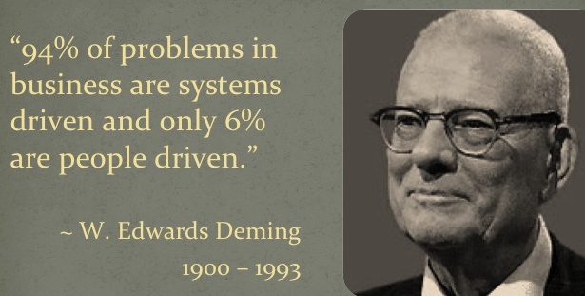
Statistical Thinking and its Role within DOE
The importance of statistical thinking derives from the fundamental principle of quality put forth by Deming: ‘Reduce variation and you improve quality’.
Customers of today and tomorrow value products and services that consistently perform, which can be achieved by systematically eliminating variation in business processes (ASQ, 1996).

Slide 40
Statistical Thinking and its Role within DOE
However, our managers lack statistical thinking and some of the possible reasons for this are as follows:
1. A shift in the organization's priorities - Global competition has forced managers to rethink how organisations are run and to search for better ways to manage. Problem solving in manufacturing and R&D, while important, is not seen as particularly relevant to the needs of management.

Slide 41
Statistical Thinking and its Role within DOE
2. Managers view statistics as a tool for ‘fire fighting’ actions - One of the most difficult challenges for every manager is to figure out how to use statistical thinking effectively to help them make effective decisions.
When a problem arises in the business, managers want to fix it as soon as possible so that they can deal with their day-to-day activities. However, what they do not realise is that the majority of problems are in systems or processes that can only be tackled with the support of senior management team.
The result is that management spends too much time ‘fire fighting’, solving the same problem again and again because the system was not changed.

Slide 42
Statistical Thinking and its Role within DOE
3. A change in the mindset of people in the enterprise - ‘If you cannot change your mind, you cannot change anything’ by Philosopher George Bernard Shaw.
It is clear that managers, quality professionals and statisticians all have new roles that require new skills. Change implies discontinuity and the destruction of familiar structures and relationships. Change can be resisted because it involves confrontation of the unknown and loss of the familiar (Huczynski and Buchanan, 2001)

Slide 43
Statistical Thinking and its Role within DOE
4. Fear of statistics by managers - ‘Even if managers were taught statistics at university, it was usually focused on complex maths and formulas rather than the application of statistical tools for problem solving and an effective decision-making process. Usually managers have their first experience with statistical thinking in a workshop inside the company, applying some tools with the guidance of an expert. Although this is the best learning method for understanding and experiencing statistical thinking, managers may still struggle to apply the principles to a different problem. This fundamental problem can be tackled by teaching usable and practical statistical techniques through real case studies at the university level.

Slide 44

Brief history of DOE
The agricultural origins, 1918-1940s
R. A. Fisher & his co-workers
Profound impact on agricultural science
Factorial designs, ANOVA
The First industrial era, 1951- late 1970s
Box & Wilson, response surfaces
Applications in the chemical & process industries
The Second industrial era, late 1970s – 1990s
Quality improvement initiatives in many companies
Taguchi and robust parameter design, process robustness
The modern era, beginning circa 1990

Slide 45
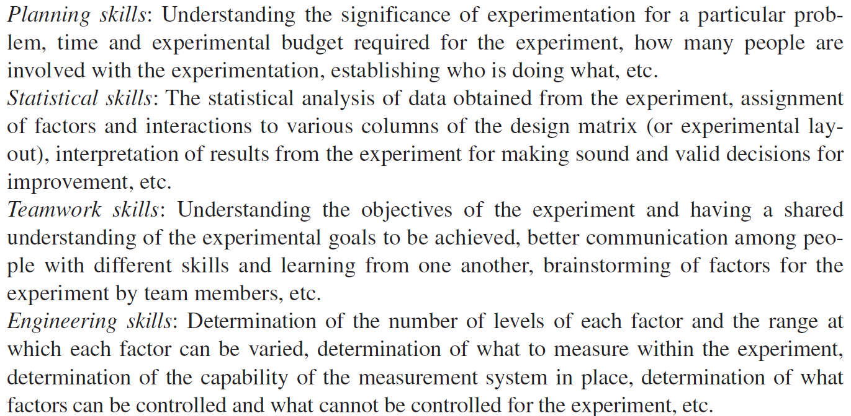
Skills required for an industrial designed experiment

Slide 46
Skills required for an industrial designed experiment

Slide 47
Characteristics of a well-planned experiment
As per, Cox 1958
Degree of precision → the probability should be high that the experiment will be able to measure differences with the degree of precision the experimenter desires. This implies an appropriate design and sufficient replication. (i.e., the standard deviation should be minimal from the experiment)
Simplicity → the design should be as simple as possible, consistent with the objective of the experiment.
Absence of systematic error → Experimental units receiving one treatment should not differ in any systematic way from those receiving another treatment so that an unbiased estimate of each treatment effect can be obtained.

Slide 48
Characteristics of a well-planned experiment
4. Range of validity of conclusions → Conclusions should have as wide a range of validity as possible.
5. Calculation of degree of uncertainty → the experiment should be designed so that it is possible to calculate the possibility of obtaining the observed result by chance alone.

Slide 49
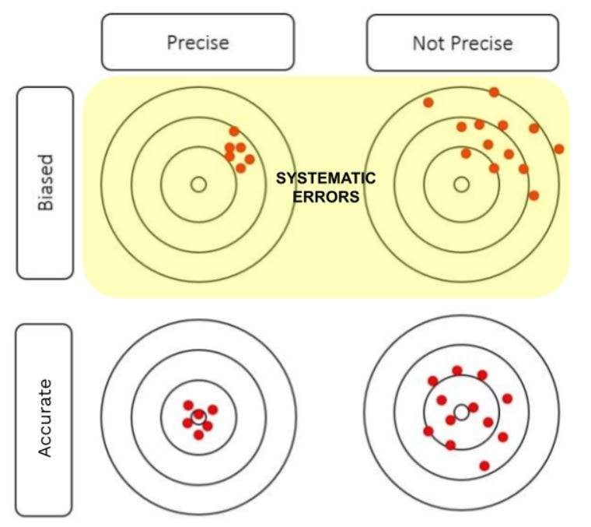
Characteristics of a well-planned experiment
Unbiased

Slide 50
Basic principles of experimentation
The basic principles of experimental design are Randomization, Replication and Blocking (Montgomery 2014). These principles make a valid test of significance possible.

Slide 51
Randomization
A statistical tool used to minimize potential uncontrollable biases in the experiment by randomly assigning material, people, order in the experimental trails to be conducted.
Purpose: to remove bias and variation
Example: chemical processing
X1: Reaction Time (80~90 min)
X2: Temperature (170 ~180 degree)
x2
(80,180)
(90,180)
x1
(80,170)
(90,170)

Slide 52
Randomization
Dorian Shainin - ‘failure to randomize the trial conditions mitigates/reduces the statistical validity of an experiment’.
The allocation of experimental units (samples) for conducting the experiment as well as the order of experimentation should be random.
When complete randomization is not possible, appropriate statistical design methods shall be used to tackle restriction on randomization.

Slide 53
Randomization
The following questions are useful if you decide to apply randomization strategy to your experiment.
What is the cost associated with change of factor levels?
Have we incorporated any noise factors in the experimental layout?
What is the set-up time between trials?
How many factors in the experiment are expensive or difficult to control?
Where do we assign factors whose levels are difficult to change from one to another level?

Slide 54
Replication
The replication is a repetition of the basic experiment without changing any factor settings.
Purpose:
To ensure a more accurate estimate of the experimental error
To increase the precision of estimate of error, which is a measure of the variability of the experimental error
Obtain a more precise estimate of the mean effect of a treatment.
x2
(80,180)
(90,180)
R1,R2,..R5
R1,R2,..R5
Each run needs to be conduct more than one time in random order.
x1
(80,170)
(90,170)
R1,R2,..R5
R1,R2,..R5

Slide 55

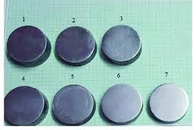
Replication
Replication involves the repetition of the experiment and obtaining the response from the same experimental set up once again on different experimental unit (samples).
The purpose of replication is to obtain the magnitude of experimental error. This error estimate (error variance) is used for testing statistically the observed difference in the experimental data.
Suppose in an experiment, five hardness measurements are obtained on five samples of a particular material using the same tip for making the indent. These five measurements are five replicates.

Slide 56
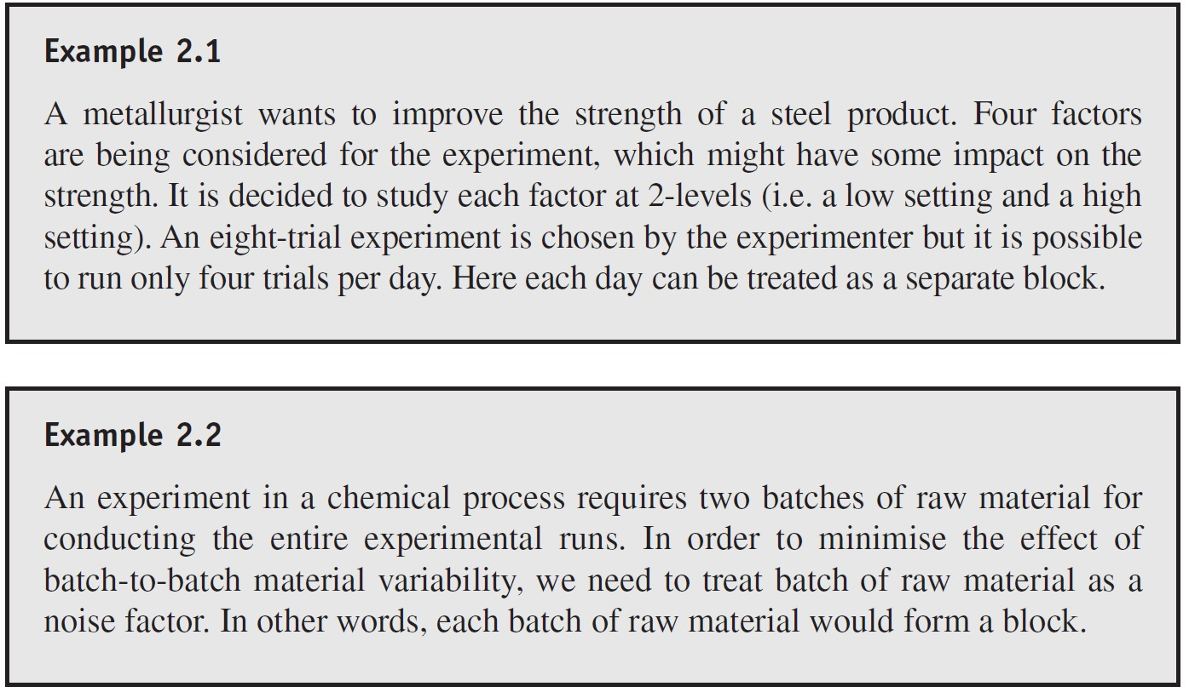
Blocking
A technique used to increase the precision of an experiment by breaking the experiment into homogeneous segments (blocks) in order to control block variability. It basically deals with noise factors.
Purpose: the main purpose of the principle of blocking is to increase the efficiency of an experimental design by decreasing the experimental error.

Slide 57
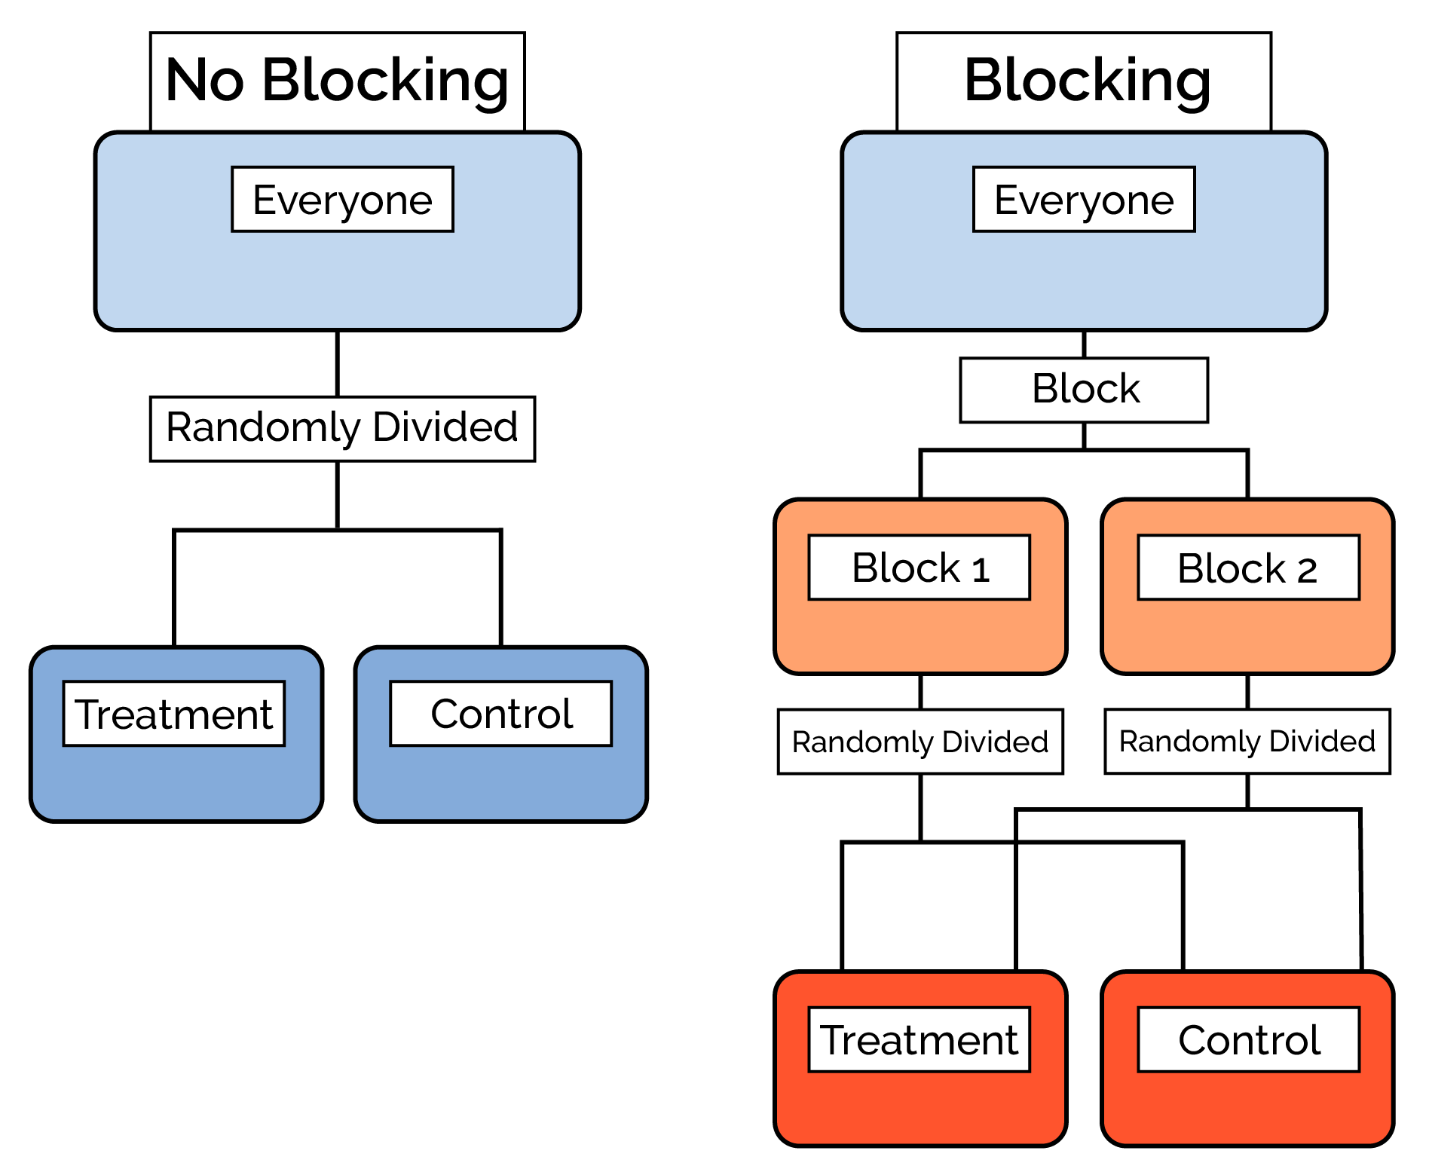
Blocking

Slide 58
Steps in experimentation
Little and Hills 1978 suggested that:
Define the problem
Determine the objectives
Select the treatments
Select the experimental material
Select the experimental design
Select the experimental unit and number of replications
Ensure proper randomization and layout

Slide 59
Steps in experimentation
Ensure proper means of data collection
Outline the statistical analysis before doing the experiment
Conduct the experiment
Analyze the data and interpret the results
Prepare complete and readable reports.

Slide 60
Steps in experimentation
1. Problem statement
2. Selection of factors, levels and ranges
3. Selection of response variable
4. Choice of experimental design
5. Conducting the experiment
6. Analysis of data
7. Conclusions and recommendations

Slide 61
1. Problem statement
A clear definition of the problem contributes to better understanding of the process being studied and the final solution of the problem.
An insight into the problem leads to a better design of the experiment.
Example:
If there is a rejection in bore diameter, specify whether the rejection is due to oversize or undersize or both.
A variation in the compression force of a shock absorber., specify clearly if there is less force or more force or both.
A defect like crack, blister, etc., specify whether its observed as random phenomenon on the product or concentrated to one specific area.

Slide 62
2. Selection of factors, levels and ranges
Factors
Several factors may influence the performance of a process or product. The following methods may be used for factor selection keeping customers in mind
Brainstorming
Flowcharting (especially for processes)
Cause-effect diagrams

Slide 63
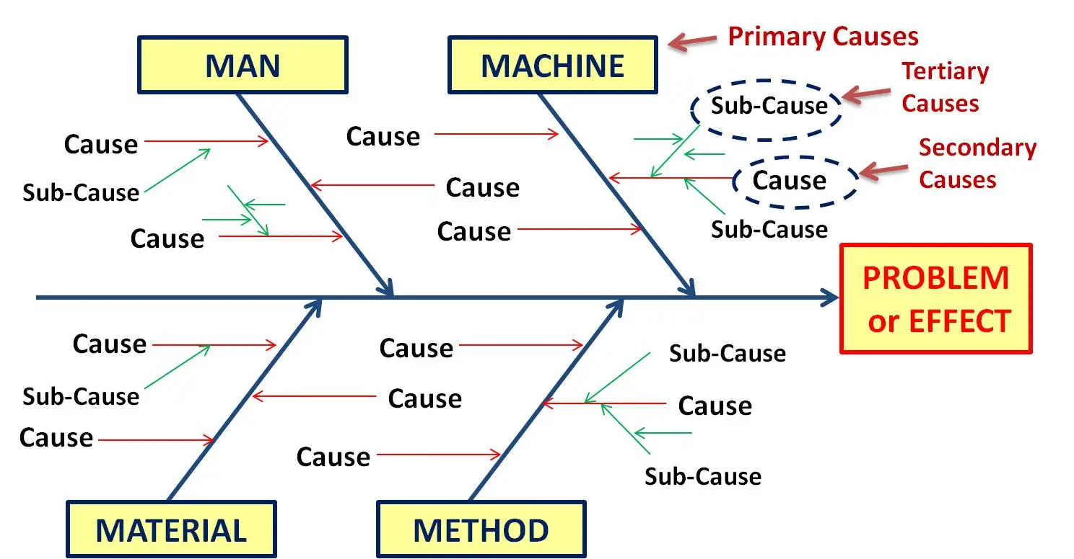
2. Selection of factors, levels and ranges
Cause-Effect diagram / Fishbone / Ishikawa diagram

Slide 64
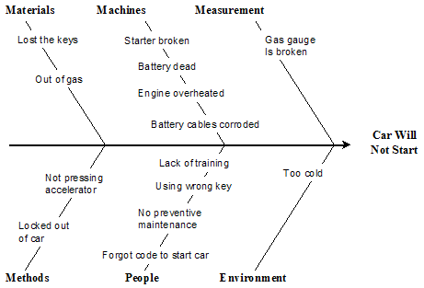

2. Selection of factors, levels and ranges
Cause-Effect diagram / Fishbone / Ishikawa diagram

Slide 65
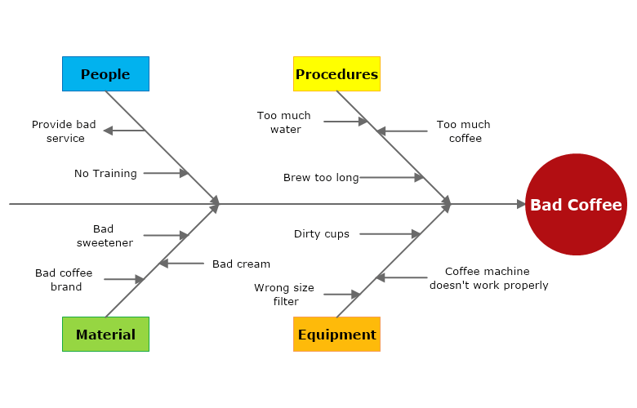

2. Selection of factors, levels and ranges
Cause-Effect diagram / Fishbone / Ishikawa diagram

Slide 66
2. Selection of factors, levels and ranges
Levels
to estimate factor effect, a minimum of two levels should be used in preliminary experimentation.
when large number of factors are included in the study, the number of levels is limited to two.
Detailed experimentation with a few factors, more number of levels can be considered

Slide 67
2. Selection of factors, levels and ranges
Range
Selection of levels for qualitative variables is easy as the level would be Sometimes ‘on’ and ‘off’ or ‘yes’ and ‘no’ or ‘high’ and ‘low’.
Selection of the extreme (within the operating range) is always safe because the system would function safely.
If levels are chosen too close together, one may not see any difference and may miss something important outside the range of experimentation.
Better to include experts and operators who are knowledgeable.

Slide 68
3. Selection of response variable
The response variable selected must be appropriate to the problem under study and provide useful information.
A clear statement is required of the response to be studied, i.e., the dependent variables to be evaluated.
Example: tensile strength, surface finish, % elongation, leakages, % defectives, etc.

Slide 69
4. Choice of experimental design
Several experimental designs like factorial designs - single factor and multifactor, fractional factorial designs, confounding designs etc.
Selecting the right type of design for the problem under study is very important, else the results will be misleading.
Choice of design involves the consideration of the number of factors and their levels, resources required such as sample size (number of replications), availability of samples, time to complete one replication, randomization restrictions, applicability of blocking etc…

Slide 70
5. Conducting the experiment
Experiments should be monitored & carried out as per the plan.
The allocation of sample as well as the order of experimentation should be random to even out the effect of unknown & controlled factors.
Complete Randomization
any trial has an equal chance of being selected for the first test.
Simple Repetition
any trial has an equal chance of being selected for the first test, but once that trial is selected all the repetitions are tested for that trial.
Complete Randomization within Blocks
where one factor may be very difficult or expensive to change the test set up for, but others are very easy. If factor A were difficult to change, the experiment could be completed in two blocks. All A1 trials could be selected randomly and then all A2 trials could be randomly selected.

Slide 71
6. Analysis of data
Statistical methods should be used to analyse the data.
Analysis of variance (ANOVA) is widely used to test the statistical significance of the effects through F-Test.
Confidence interval estimation is also part of the data analysis. empirical models are developed relating the dependent (response) and independent variables (factors).
Residual analysis and model adequacy checking are also part of the data analysis procedure.
Statistical analysis of data is a must for academic and scientific purpose.
graphical analysis and normal probability plot of the effects may be preferred by Industry

Slide 72
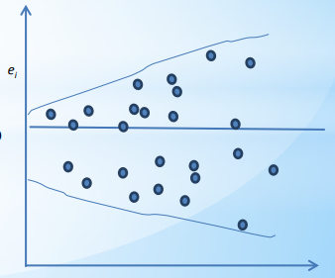
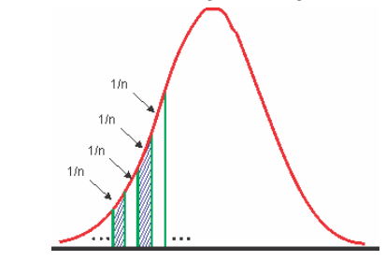
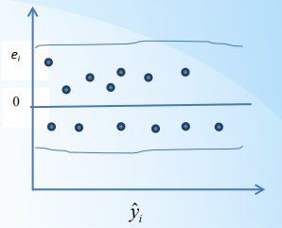
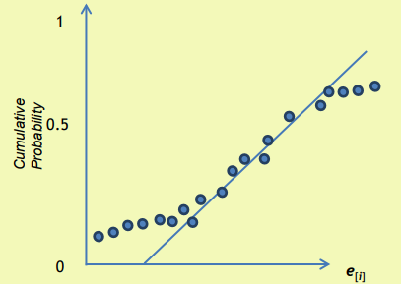
6. Analysis of data

Slide 73
7. Conclusions and recommendations
The experimenter must interpret the results and recommend the same for possible implementation.
The recommendations include the settings of levels for all the factors (input variables studied) that optimizes the output (response).
It is always better to conduct conformation tests using the recommend levels for the factors to validate the conclusions.

Slide 74
Selection of Quality Characteristics for Industrial Experiments
The selection of an appropriate quality characteristic is vital for the success of an industrial experiment.
To identify a good quality characteristic, it is suggested to start with the engineering or economic goal.
Having determined this goal, identify the fundamental mechanisms and the physical laws affecting this goal.

Slide 75
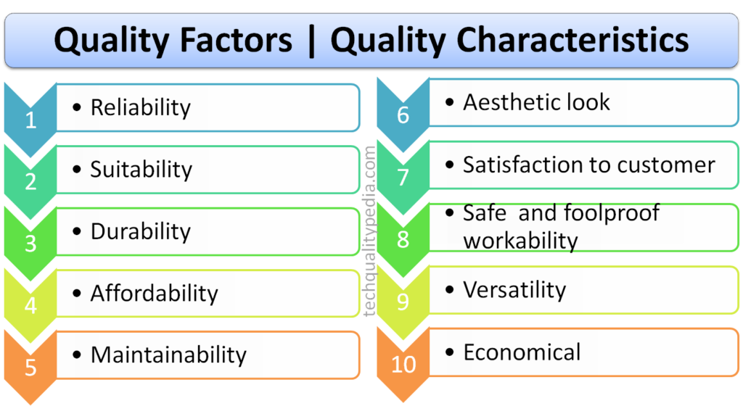
Selection of Quality Characteristics for Industrial Experiments

Slide 76
Selection of Quality Characteristics for Industrial Experiments
Try to use quality characteristics that are easy to measure.
Quality characteristics should, as far as possible, be continuous variables.
Use quality characteristics which can be measured precisely, accurately and with stability.
For complex processes, it is best to select quality characteristics at the sub-system level and perform experiments at this level before attempting overall process optimisation.
Quality characteristics should cover all dimensions of the ideal function or the input–output relationship.

Slide 77
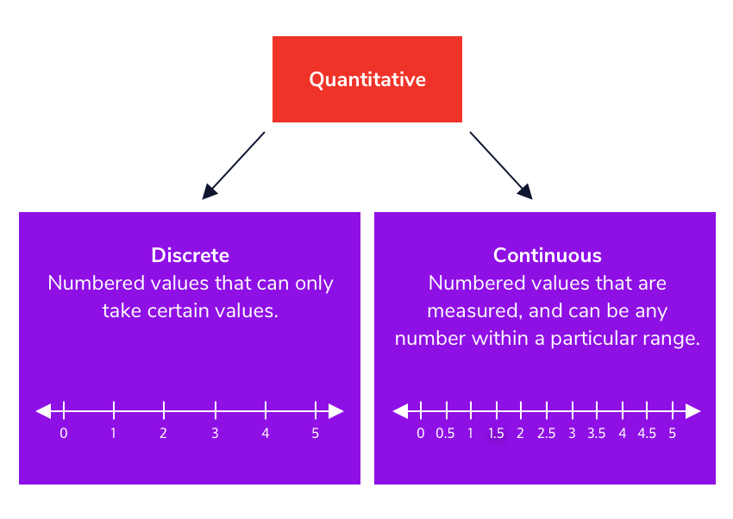
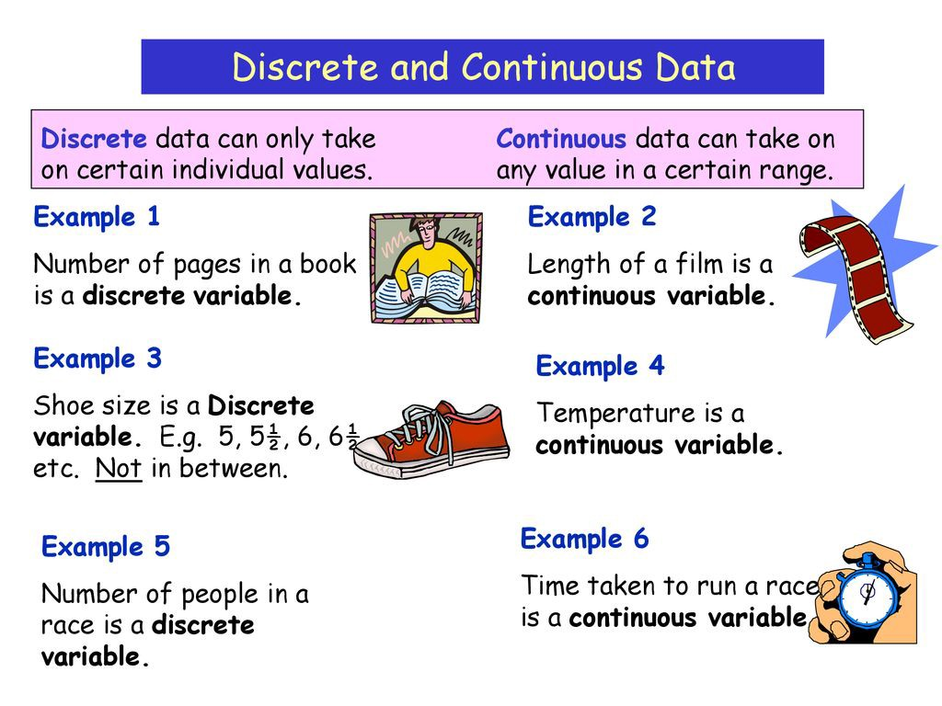
Selection of Quality Characteristics for Industrial Experiments

Slide 78
Choice of sample size
Variable Data:
Selection of sample size is important.
A minimum of one test for each trial is required.
More than one test per trial increases the sensitivity of experiment to detect small changes in averages of populations.
The sample size (the number of replications)depends on the resources available (the experimental units) and the time required for conduct of the experiment.
The sample size should be as large as possible so that it meets the statistical principles and also facilitate a better estimate of the effect.

Slide 79
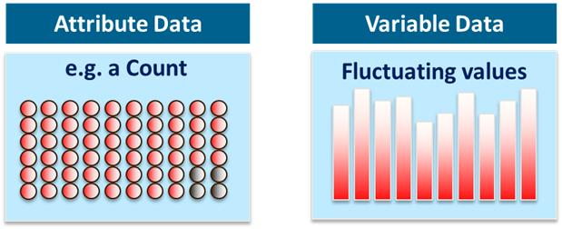
Choice of sample size
Attribute Data:
Provides less discrimination than variable data.
when an item is classified as defective, the measure of how bad is not indicated. Because of this reduced discrimination, many pieces of attribute data are required.

Slide 80
Choice of sample size
Attribute Data:
Example: In a study on defective parts, if 20 defectives are required and Suppose the past defective percent in a process is 5%. Then, the total sample size required (all trials/ runs) shall be 400.

Slide 81
Degrees of freedom (DOF)
In the context of statistics, DOF refers to the number of independent and fair comparisons that can be made in a set of data.
In the context of DOE,
Degrees of freedom for a main effect = Number of levels - 1
The number of degrees of freedom for the entire experiment is equal to one less than the total number of data points or observations.

Slide 82
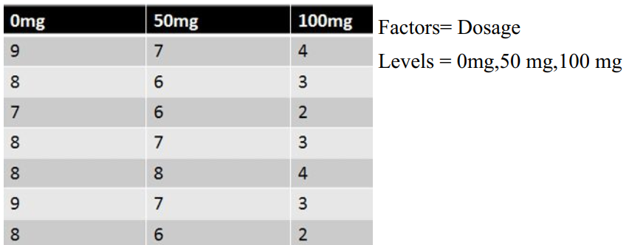
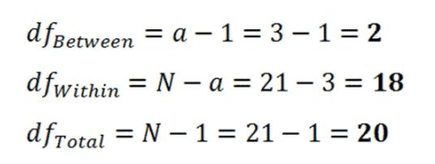
Degrees of freedom (DOF)

Slide 83
Degrees of freedom (DOF)
In an 8 trial experiment , where each trial was replicated twice
So the total observations are 2 x 8 = 16 , therefore the DOF for each experiment is equal to 15 (i.e. 16 -1)
The degrees of freedom for an interaction is equal to the product of the degrees of freedom associated with each factor involved in that particular interaction effect.

Slide 84
Degrees of freedom (DOF)
Dosage ‘a’
Dosage ‘b’
b - 1
Degrees of freedom for Interaction = (a-1) x (b-1)

Slide 85
Example 1
Consider a certain painting process which results in various problems such as
Orange peel
poor appearance
Voids, etc.
Often, experimenters measure these characteristics as data and try to optimize the quality characteristic.
It is not the function of the coating process to produce an orange peel.
The problem could be due to excess variability of the coating process due to noise factors such as variability in viscosity, ambient temperature, etc.

Slide 86
Example 1
We should make every effort to gather data that relate to the engineering function itself and not to the symptom of variability.
One fairly good characteristic to measure for the coating process is the coating thickness.
It is important to understand that excess variability of coating thickness from its target value. This could lead to problems such as orange peel or voids.
The sound engineering strategy is to design and analyse an experiment so that best process parameter settings can be determined in order to yield a minimum variability of coating thickness around the specified target thickness.

Slide 87
Example 2
In the service organisations, the selection of quality characteristics is not very straight forward due to the human behavioural characteristics present in the delivery of the service.
In the banking sector
The number of processing errors
The processing time for certain transactions
The waiting time to open a bank account, etc.
It is important to measure those quality characteristics which have an impact on customer satisfaction.

Slide 88
Example 3
Health care services
The proportion or fraction of medication errors
The proportion of cases with inaccurate diagnosis
The waiting time to get a treatment
The waiting time to be admitted to an A&E department
The number of malpractice claims in a hospital every week or month, etc.

Slide 89
Understanding key interactions in a process
For modern industrial processes, the interactions between the factors or process parameters are a major concern to many engineers and managers, and therefore should be studied, analyzed and understood properly for problem solving and process optimisation problems.
For many process optimisation problems in industries, the root cause of the problem is sometimes due to the interaction between the factors rather than the individual effect of each factor on the output performance characteristic (or response).
Here performance characteristic is the characteristic of a product/ service which is most critical to customers (Logothetis, 1994)

Slide 90
Understanding key interaction in processes
Example : Wave-soldering process of a PCB assembly line in a certain electronic industry.
Aim : To reduce the number of defective solder joints obtained from the soldering process.
The average defect rate based on the existing conditions is 410 ppm (parts per million)
To perform a simple experiment to understand the influence of wave-soldering process parameters on the number of defective solder joints.

Slide 91
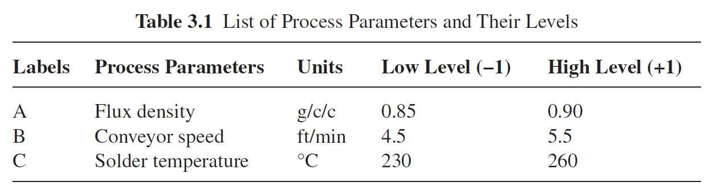
Understanding key interaction in processes
First Attempt through OVAT approach – 2 levels, low level (represented by −1) and high level (represented by +1) for each parameter.
Table 1 List of Process Parameters and Their Levels

Slide 92
Understanding key interaction in processes
What is OFAT ?
One Factor at a Time (OFAT)
The OFAT method consists of selecting a starting point, or baseline set of levels, for each factor, and then successively varying each factor over its range with the other factors held constant at the baseline level. After all tests are performed, a series of graphs are usually constructed showing how the response variable is affected by varying each factor with all other factors held constant.

Slide 93
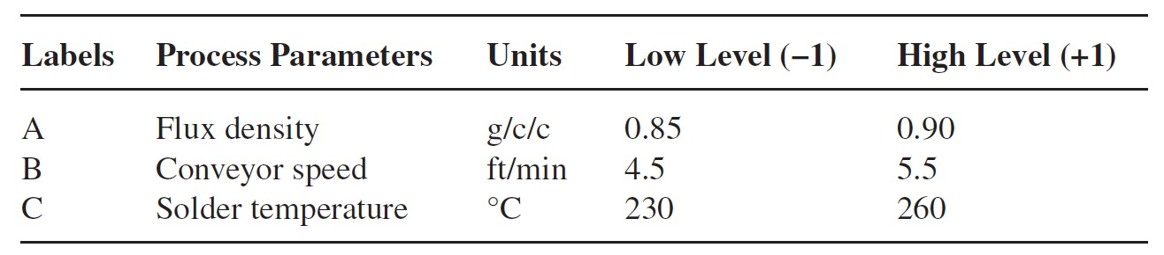
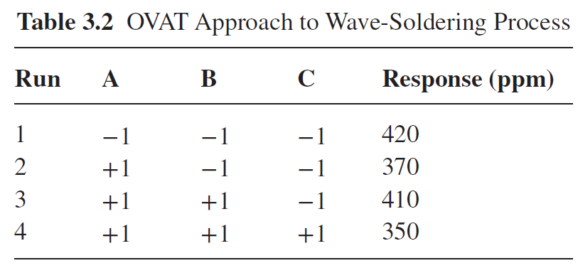
Understanding key interaction in processes
The experimental layout (or design matrix)
First Trial with all process parameters kept at low level

Slide 94
Understanding key interaction in processes
The difference in the responses between the trials 1 and 2 provides an estimate of the effect of process parameter ‘A’. From Table 3.2, the effect of ‘A’ (370 − 420 = −50) was estimated when the levels of ‘B’ and ‘C’ were at low levels. There is no guarantee whatsoever that ‘A’ will have the same effect for different conditions of ‘B’ and ‘C’.
Similarly, the effects of ‘B’ and ‘C’ can be estimated.
In the above experiment, the response values corresponding to the combinations A (−1) B (+1), A (−1) C (+1) and B (−1) C (+1) are missing.
Therefore OVAT to experimentation can lead to unsatisfactory conclusions and in many cases it would even lead to false optimum conditions. In this case, the team failed to study the effect of each factor at different conditions of other factors. In other words, the team failed to study the interaction between the process parameters.

Slide 95
Understanding key interaction in processes
Interactions occur when the effect of one process parameter depends on the level of the other process parameter. In other words, the effect of one process parameter on the response is different at different levels of the other process parameter.
In order to study interaction effects among the process parameters, we need to vary all the factors simultaneously (Anderson and Whitcomb, 2000).

Slide 96
Understanding key interaction in processes
For the above wave-soldering process, the engineering team employed a Full Factorial Experiment (FFE) and each trial or run condition was replicated twice to observe variation in results within the experimental trials.
The results of the FFE are given in Table 3.3.
Each trial condition was randomised to minimise the effect of undesirable disturbances or external factors which were uncontrollable or expensive to control during the experiment.

Slide 97
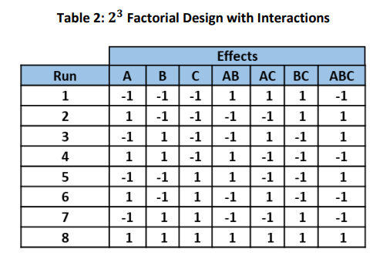
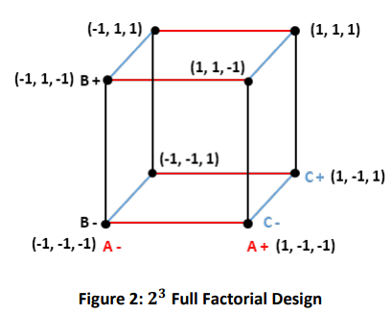
Understanding key interaction in processes
The experimental layout (or design matrix) – using Full Factorial
2³ Full Factorial Experiment

Slide 98
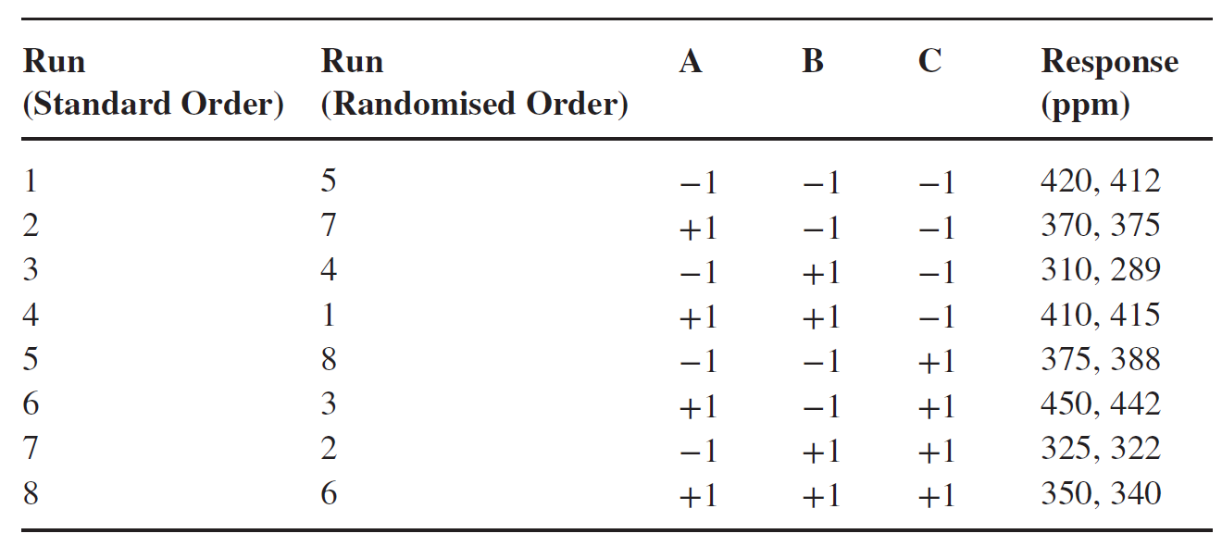
Understanding key interaction in processes
The experimental layout (or design matrix) – using Full Factorial
2³ Full Factorial Experiment
run condition was replicated twice to observe variation in results within the experimental trials.
Each trial condition was randomised

Slide 99
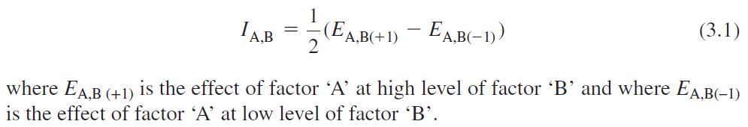
Understanding key interaction in processes
As it is an FFE, it is possible to study all the interactions among the factors A, B and C. The interaction between two process parameters (say, A and B) can be computed using the following equation:

Slide 100
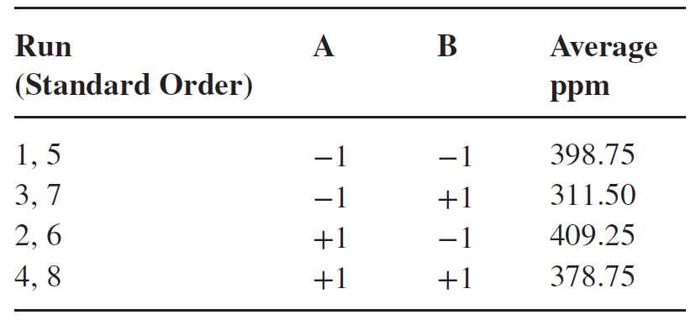
Understanding key interaction in processes
In order to study the interaction between A (flux density) and B (conveyor speed), it is important to form a table for average ppm values at the four possible combinations of A and B (i.e. A(−1) B(−1), A(−1) B(+1), A(+1) B(−1) and A(+1) B(+1)).
Run 1 A (-1) & B(-1): 420,412; Run 5 A (-1) & B(-1): 375,388
Average: (420+412+375+388)/4 = 398.75

Slide 101
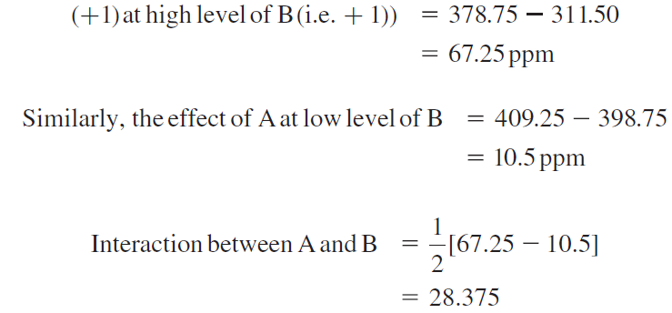
Understanding key interaction in processes
From the previous Table, the effect of ‘A’ (i.e., going from low level (–1) to high level
ppm

Slide 102
Understanding key interaction in processes
To determine whether two process parameters are interacting or not, one can use a simple but powerful graphical tool called interaction graphs.
If the lines in the interaction plot are parallel, there is no interaction between the process parameters (Barton, 1990).
This implies that the change in the mean response from low to high level of a factor does not depend on the level of the other factor.
On the other hand, if the lines are non-parallel, an interaction exists between the factors. The greater the degree of departure from being parallel, the stronger the interaction effect.

Slide 103
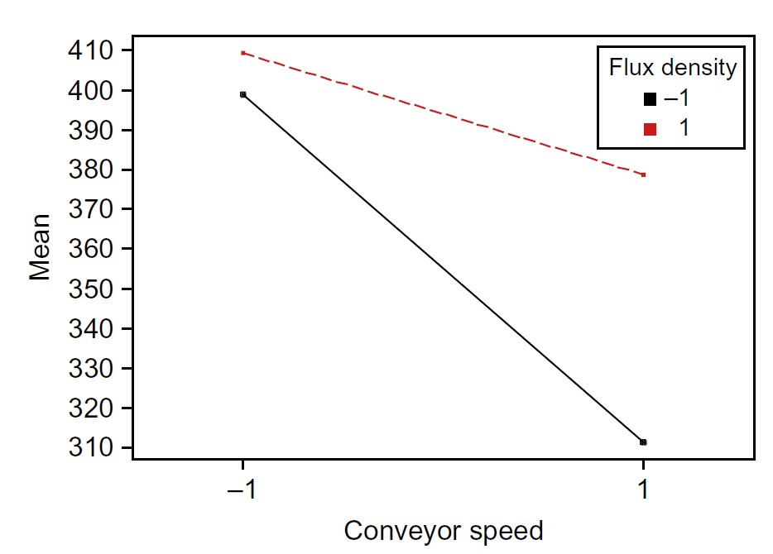
Understanding key interaction in processes
Figure 1 Interaction plot between flux density and conveyor speed
The interaction graph between flux density and conveyor speed shows that the effect of conveyor speed on ppm at two different levels of flux density is not the same. This implies that there is an interaction between these two process parameters. The defect rate (in ppm) is minimum when the conveyor speed is at high level and flux density at low level.

Slide 104
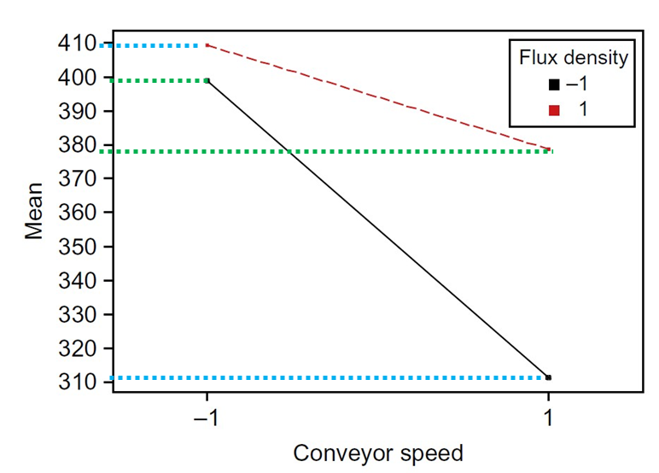
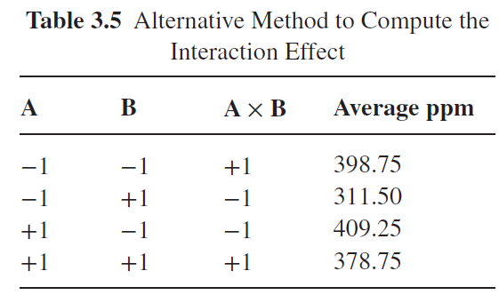
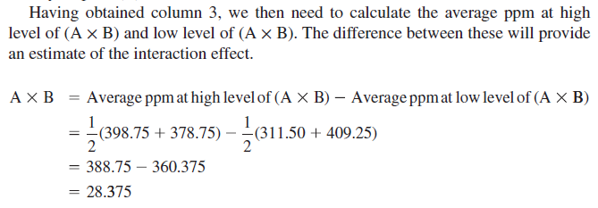
Alternative Method for Calculating the Two-Order Interaction Effect
In order to compute the interaction effect between flux density and conveyor speed, we need to first multiply both factors effect

Slide 105
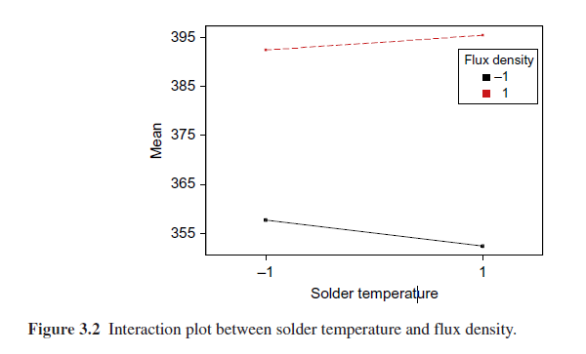
Alternative Method for Calculating the Two-Order Interaction Effect

Slide 106
Alternative Method for Calculating the Two-Order Interaction Effect
Now consider the interaction between flux density (A) and solder temperature.
The graph shows that the effect of solder temperature at different levels of flux density is almost the same. Moreover, the lines are almost parallel, which indicates that there is little interaction between these two factors.
The interaction plot suggests that the mean solder defect rate is minimum when solder temperature is at high level and flux density at low level.
Note: Non-parallel lines are an indicator of the existence of interactions between two factors and parallel lines indicate no interactions between the factors.

Slide 107
Synergistic Interaction Vs Antagonistic Interaction
The effects of process parameters can be either fixed or random.
Fixed Process Parameters
Fixed process parameter effects occur when the process parameter levels included in the experiment are controllable and specifically chosen because they are the only ones for which inferences are desired.
For example, if you want to determine the effect of temperature at 2-levels (180°C and 210°C) on the viscosity of a fluid, then both180°C and 210°C are considered to be fixed parameter levels.

Slide 108
Synergistic Interaction Vs Antagonistic Interaction
The effects of process parameters can be either fixed or random.
Random Process Parameters
Random process parameter effects are associated with those parameters whose levels are randomly chosen from a large population of possible levels.
Inferences are not usually desired on the specific parameter levels included in an experiment, but rather on the population of levels represented by those in the experiment.
For example, Factor levels represented by batches of raw materials drawn from a large population

Slide 109
Synergistic Interaction Vs Antagonistic Interaction
Synergistic interaction means that the effect of two chemicals taken together is greater than the sum of their separate effect at the same doses. An example is pesticide and fertilizer. (i.e., Combined effect of two factors is greater than the individual factors on the response. In other words, when higher level of one independent variable enhances the effect of another independent variable)

Slide 110
Synergistic Interaction Vs Antagonistic Interaction
Antagonistic interaction means that the effect of two chemicals is actually less than the sum of the effect of the two drugs taken independently of each other. This is because the second chemical increases the excretion of the first, or even directly blocks its toxic actions. (i.e., Combined effect of two factors is lesser than the individual factors on the response. In other words, When main effect is non-significant and interaction is significant. In this situation the two independent variables tend to reverse each others effect.

Slide 111
Synergistic Interaction
The lines on the plot do not cross each other
Figure 3 Synergistic interaction between two factors A and B.

Slide 112
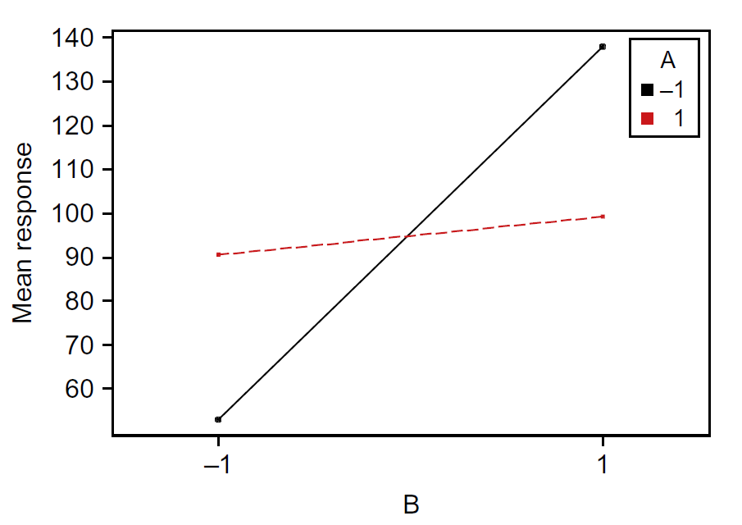
Antagonistic Interaction
The lines on the plot cross each other
Figure 4 Antagonistic interaction between two factors A and B.

Slide 113
Robust Design
Dr. Genichi Taguchi was a widely acknowledged leader in the U.S. industrial quality movement.
Credited for starting the “Robust Design” movement in Japan in 1950’s.
Robust design ( creating an insensitive design towards uncontrollable variables

Slide 114
Robust Design
It focuses on improving the fundamental function of the product or process, thus facilitating flexible designs and concurrent engineering to minimally impacted by external forces, such as environment,operating, or manufacturing conditions.
It is the most powerful method available to reduce product cost, improve quality, and simultaneously reduce development interval
It used in diverse industries: automobiles, xerography, telecommunications, electronics, software, etc

Slide 115
Robust Design
Step 1 : Problem Formulation
Step 2 : Data Collection/Simulation
Step 3 : Factor Effects Analysis
Step 4 : Prediction/Confirmation

Slide 116
Robust Design
Step 1 : Problem Formulation
This Steps Include :
1. Developing P-Diagram
2. Defining Ideal Function and S/N Ratio.
S/N = (Intended output) / (Unintended output)
= (What we want) / (What we don't want)
= (Useful energy) / (Waste energy)
3. Planning Experiments

Slide 117
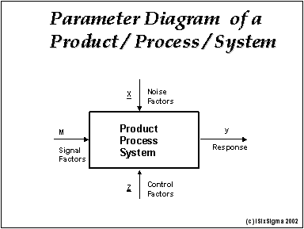
Robust Design
1. Developing P-Diagram
It used to identify signal (input), response (output), noise factor (factors that are beyond the control of the design), control factors (factors that can be specified by the designer). Noise factors may include:
– parameter variations
– environmental changes
– operating conditions
– manufacturing variations

Slide 118
Robust Design enables engineers to:
Develop products and processes which perform consistently as intended under a wide range of user's conditions throughout their life cycle (durable and reliable)
Maximize robustness-improve the intended function of the product by developing and increasing insensitivity to noise factors which tend to degrade performance
Develop or change product formulas and process settings to achieve desired performance at the lowest cost and in the shortest time
Simplify designs and processes to reduce cost

Slide 119
Robust Design
Reduce time to design/develop new products & processes
Improve performance of existing processes
Improve reliability and performance of products
Achieve product & process robustness
Evaluation of materials, design alternatives, setting component & system tolerances, etc.

Slide 120
Thank you

